Slide 1
Primary Schools Toys
Geraldine Lee
geraldine343@gmail.com
Dr Mark Glickman
drmarkglickman@yahoo.com

Slide 2
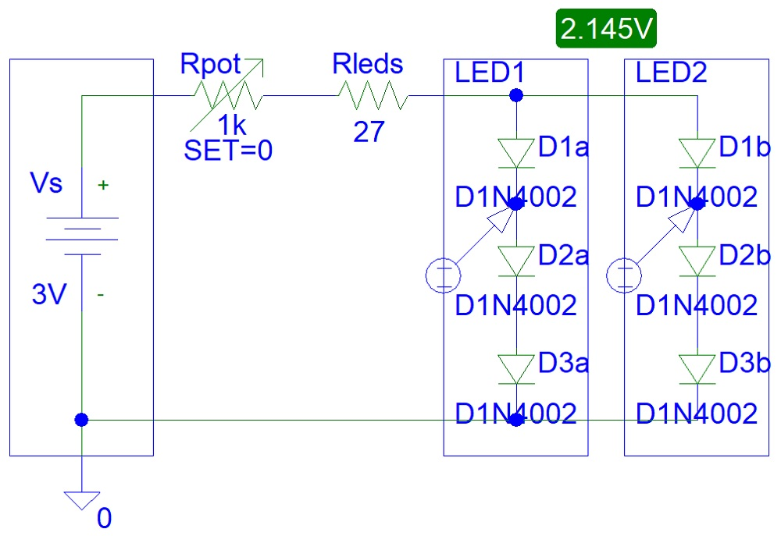
Instructables Blinking Robot Circuit

Slide 3
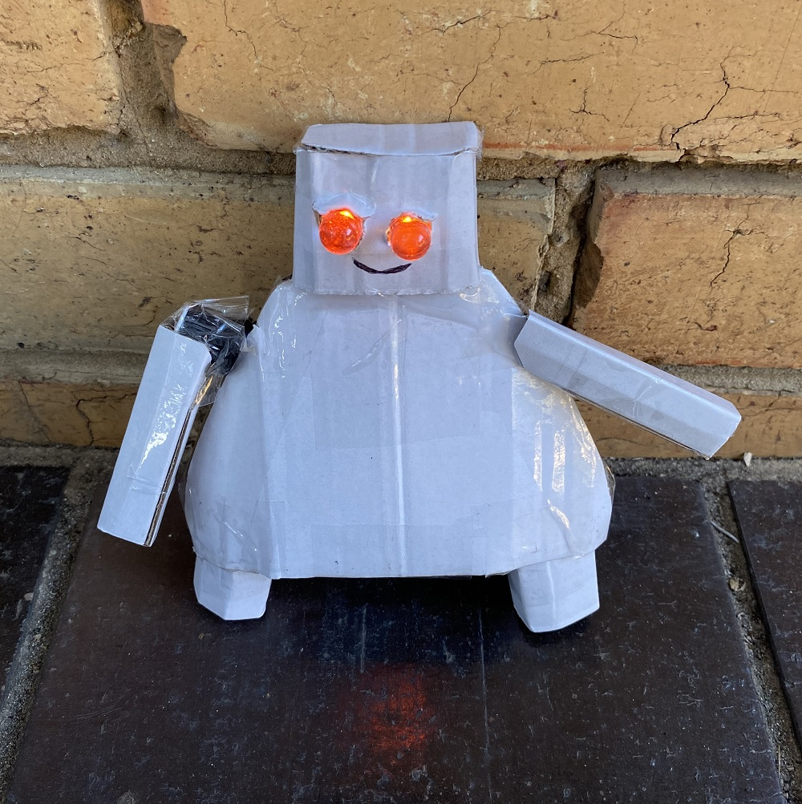
Instructables Blinking Robot Photo

Slide 4

Instructables Blinking Robot Video 1

Slide 5
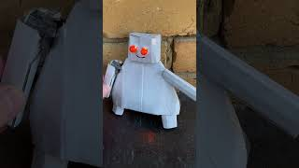
Instructables Blinking Robot Video 2

Slide 6
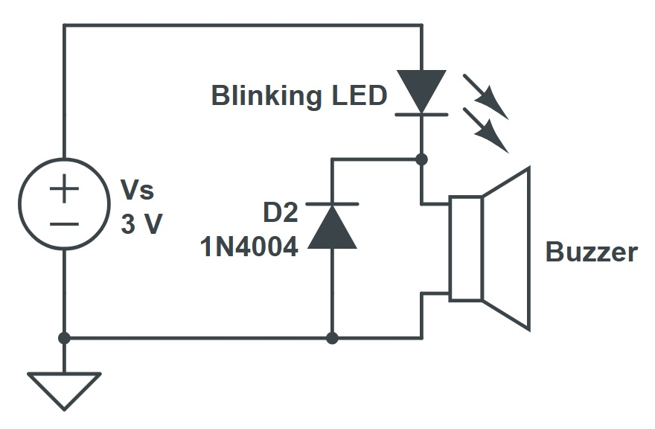
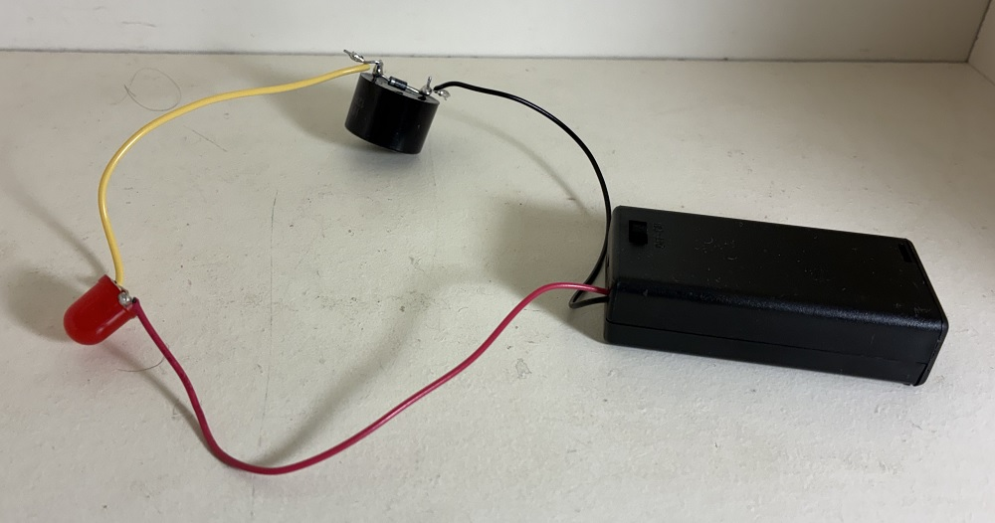
Toy Ambulance Vans Circuit

Slide 7
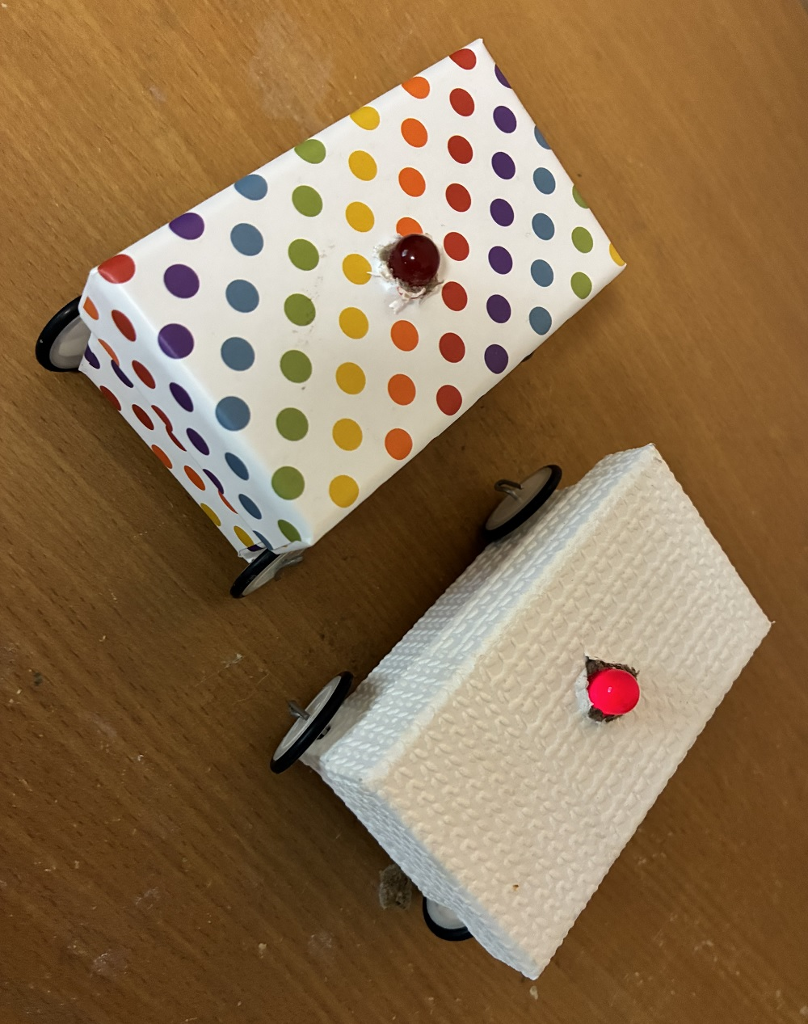
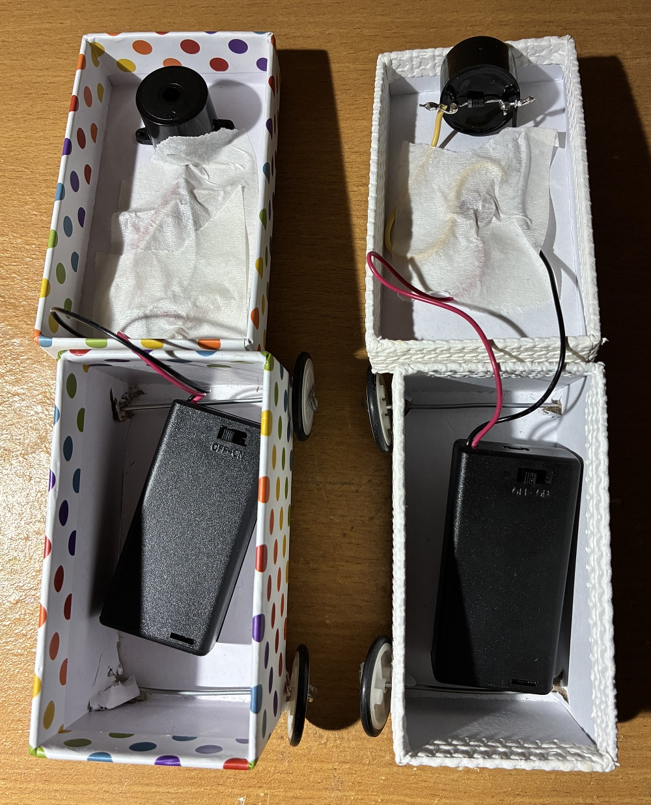
Toy Ambulance Vans Photos

Slide 8
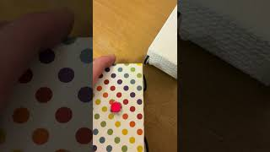
Toy Ambulance Vans Video

Slide 9
References
https://instructables.com/member/diyelectronics
https://hackaday.io/diyelectronics
https://instructables.com/member/simplecircuits
https://hackaday.io/simplecircuits
https://instructables.com/member/simplecomponents
https://hackaday.io/simplecomponents
https://instructables.com/member/cheapcircuits
https://hackaday.io/cheapcircuits
https://instructables.com/member/supercircuits
https://hackaday.io/supercircuits

Slide 10
References
https://instructables.com/member/diycircuits
https://hackaday.io/diycircuits
https://instructables.com/member/usedcomponents
https://hackaday.io/usedcomponents
https://instructables.com/member/recycledcircuits
https://hackaday.io/recycledcircuits
https://instructables.com/member/recycledcomponents
https://hackaday.io/recycledcomponents
https://instructables.com/member/lowcostcircuits
https://hackaday.io/lowcostcircuits

