Slide 1
Primary School Motor Drivers 2
Geraldine Lee
geraldine343@gmail.com
Dr Mark Glickman
drmarkglickman@yahoo.com

Slide 2
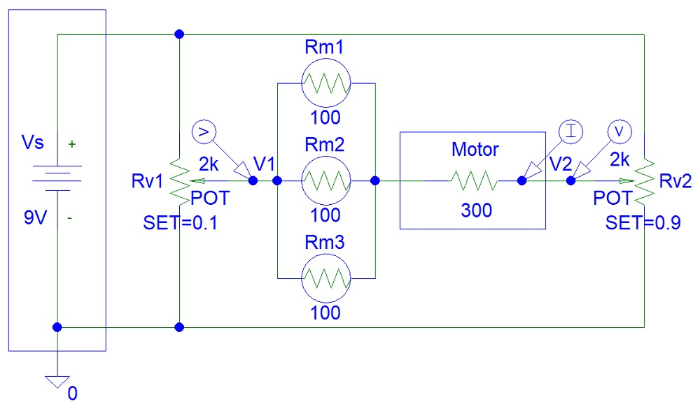
Dual Control Motor
You need low value potentiometers:

Slide 3
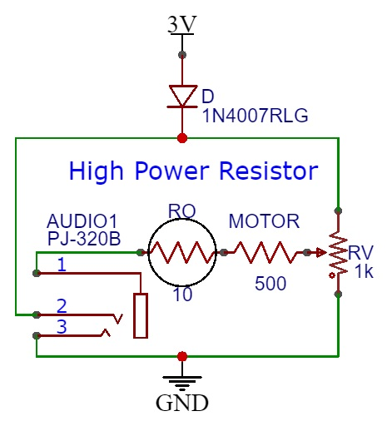
Resistor Motor Driver
Circuit design:

Slide 4
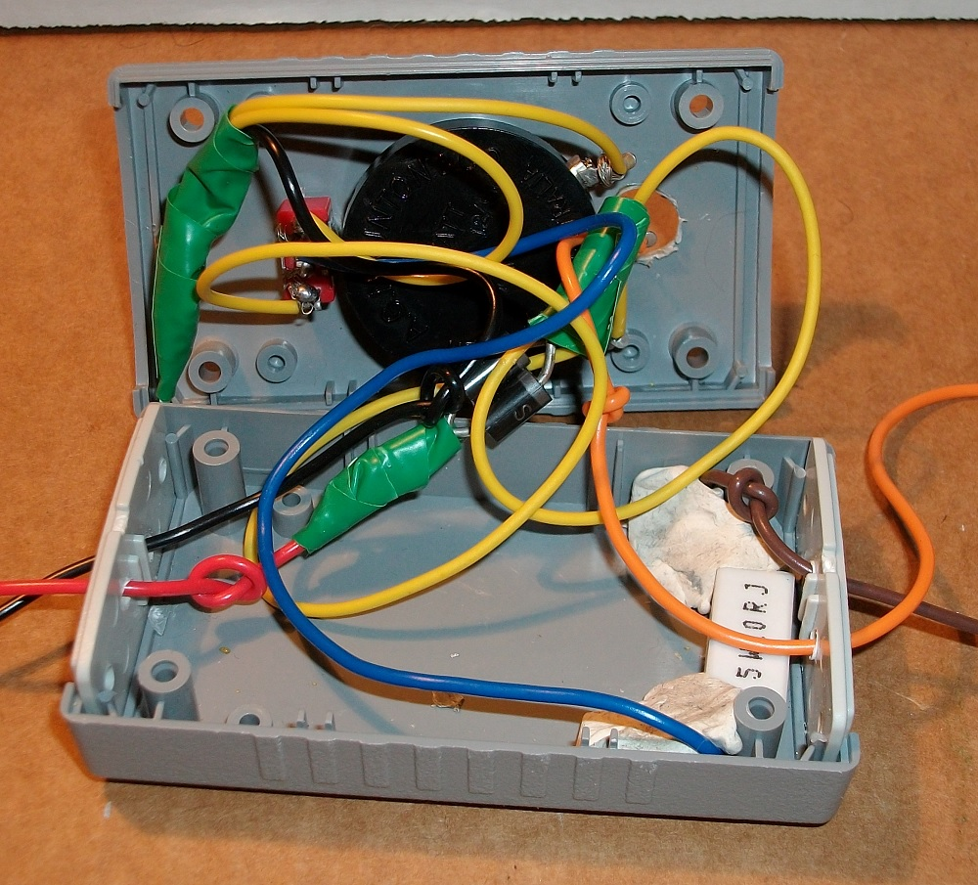
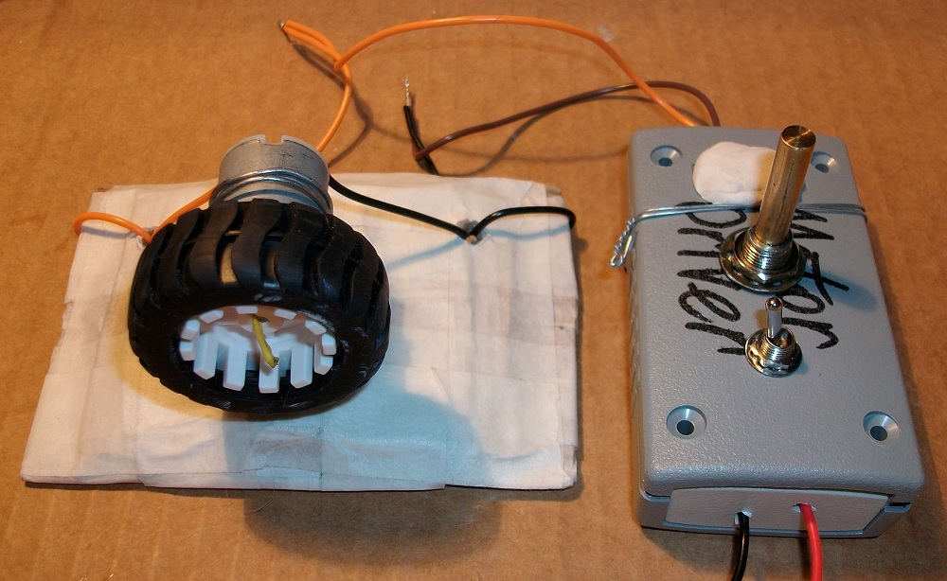
Resistor Motor Driver
Circuit photo:

Slide 5
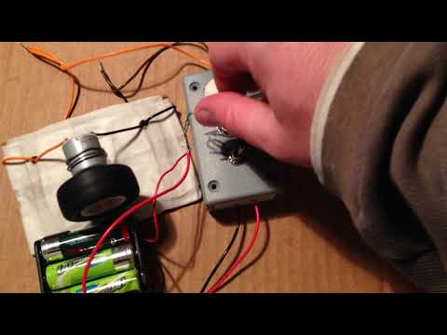
Resistor Motor Driver Video
There are six AA 1.5 V batteries in this video, not just three:

Slide 6
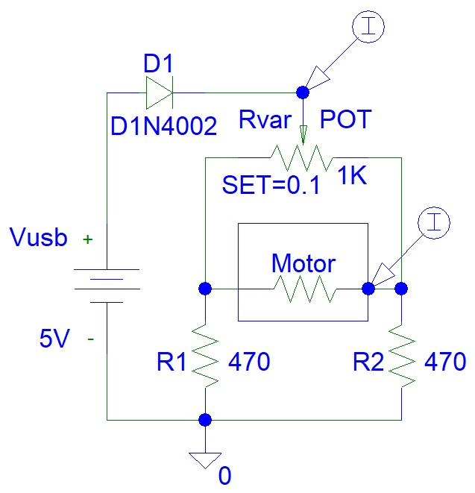
H-Bridge Motor Driver

Slide 7
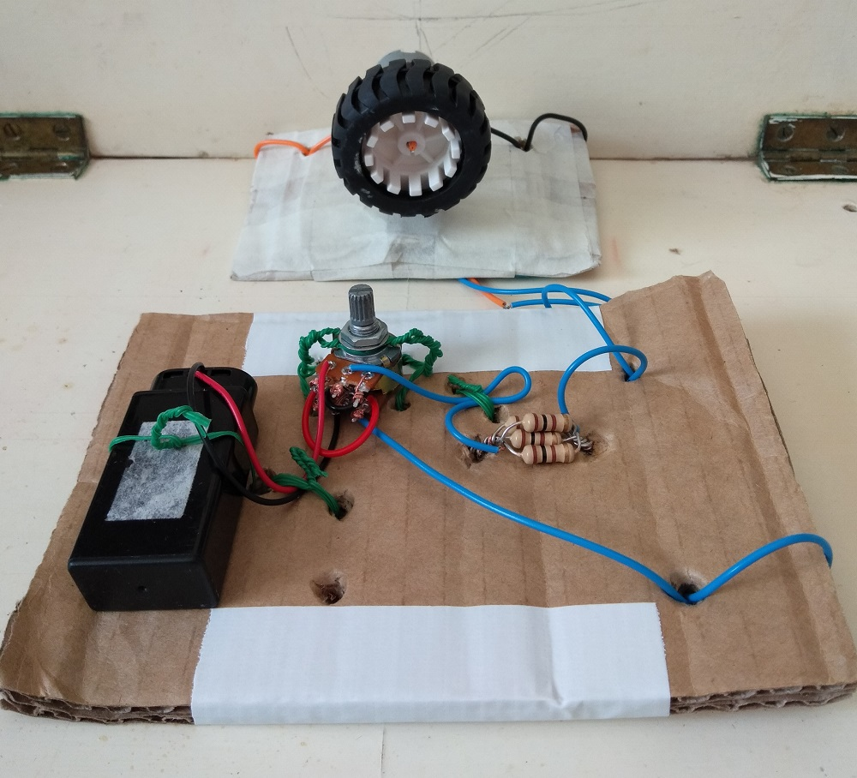
Dual Control Motor
You can use double gang potentiometer:

Slide 8
References
https://instructables.com/member/diyelectronics
https://hackaday.io/diyelectronics
https://instructables.com/member/simplecircuits
https://hackaday.io/simplecircuits
https://instructables.com/member/simplecomponents
https://hackaday.io/simplecomponents
https://instructables.com/member/cheapcircuits
https://hackaday.io/cheapcircuits
https://instructables.com/member/supercircuits
https://hackaday.io/supercircuits

Slide 9
References
https://instructables.com/member/diycircuits
https://hackaday.io/diycircuits
https://instructables.com/member/usedcomponents
https://hackaday.io/usedcomponents
https://instructables.com/member/recycledcircuits
https://hackaday.io/recycledcircuits
https://instructables.com/member/recycledcomponents
https://hackaday.io/recycledcomponents
https://instructables.com/member/lowcostcircuits
https://hackaday.io/lowcostcircuits

