Slide 1
Primary School Motor Drivers 1
Geraldine Lee
geraldine343@gmail.com
Dr Mark Glickman
drmarkglickman@yahoo.com

Slide 2
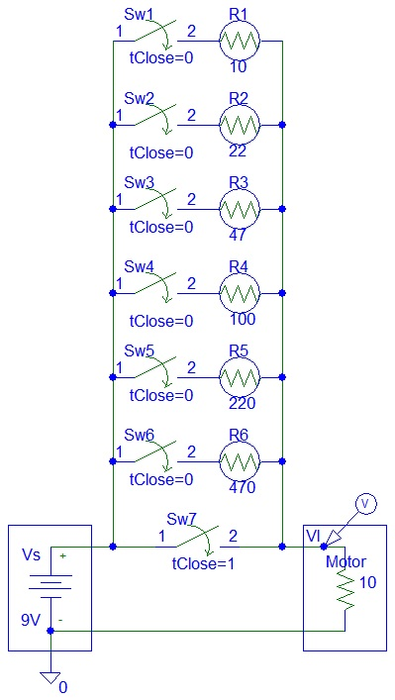
Resistor Speed Controlled Motor
Higher resistor values cause the motor to rotate slowly.

Slide 3
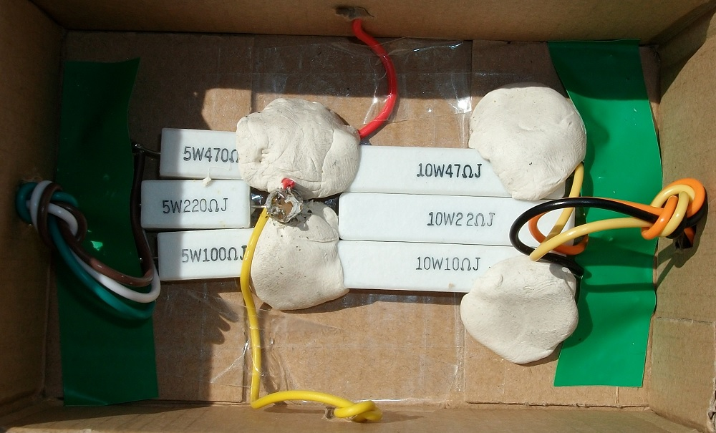
Resistor Speed Controlled Motor
Those high power resistors should be used for high power motors:

Slide 4
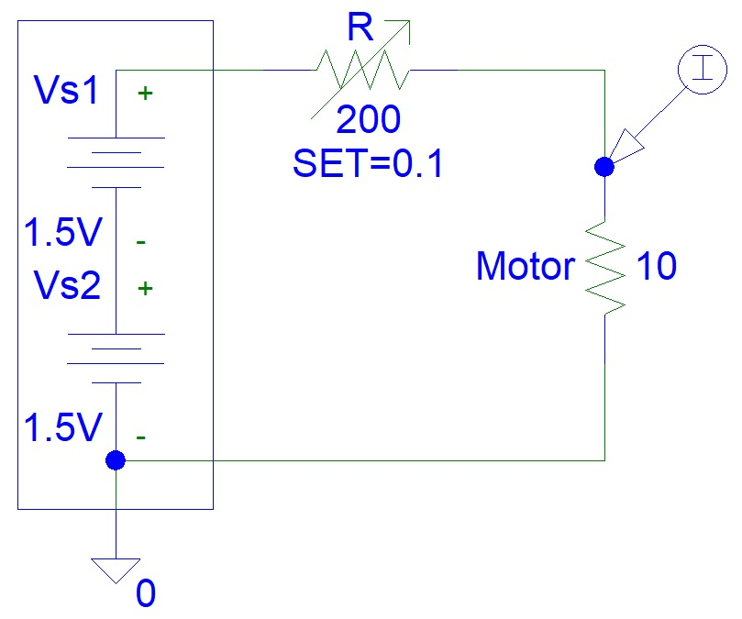
Variable Resistor Motor Driver Circuit

Slide 5
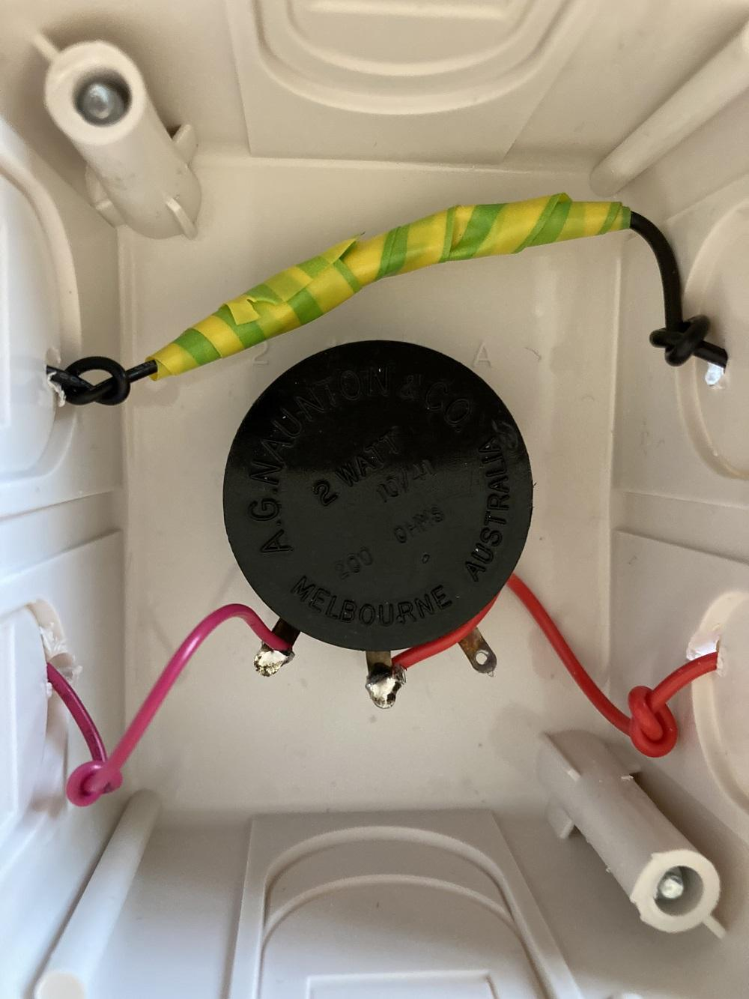
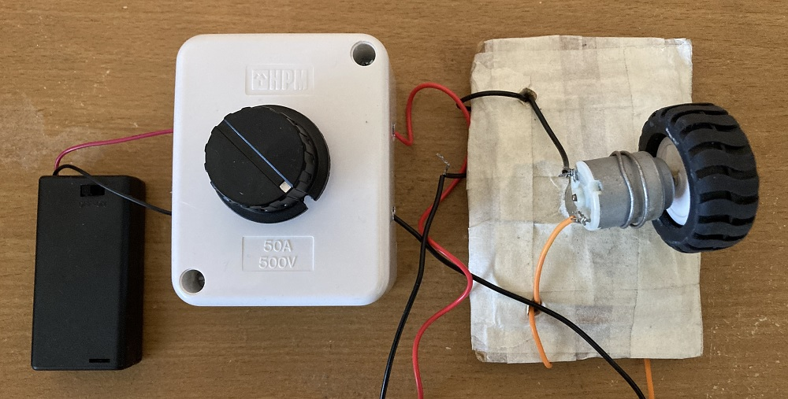
Variable Resistor Motor Driver Photos

Slide 6
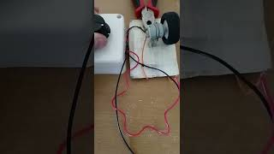
Variable Resistor Motor Driver Video

Slide 7
References
https://instructables.com/member/diyelectronics
https://hackaday.io/diyelectronics
https://instructables.com/member/simplecircuits
https://hackaday.io/simplecircuits
https://instructables.com/member/simplecomponents
https://hackaday.io/simplecomponents
https://instructables.com/member/cheapcircuits
https://hackaday.io/cheapcircuits
https://instructables.com/member/supercircuits
https://hackaday.io/supercircuits

Slide 8
References
https://instructables.com/member/diycircuits
https://hackaday.io/diycircuits
https://instructables.com/member/usedcomponents
https://hackaday.io/usedcomponents
https://instructables.com/member/recycledcircuits
https://hackaday.io/recycledcircuits
https://instructables.com/member/recycledcomponents
https://hackaday.io/recycledcomponents
https://instructables.com/member/lowcostcircuits
https://hackaday.io/lowcostcircuits

