Slide 1
Primary School
Bad Circuits
Geraldine Lee
geraldine343@gmail.com
Dr Mark Glickman
drmarkglickman@yahoo.com

Slide 2
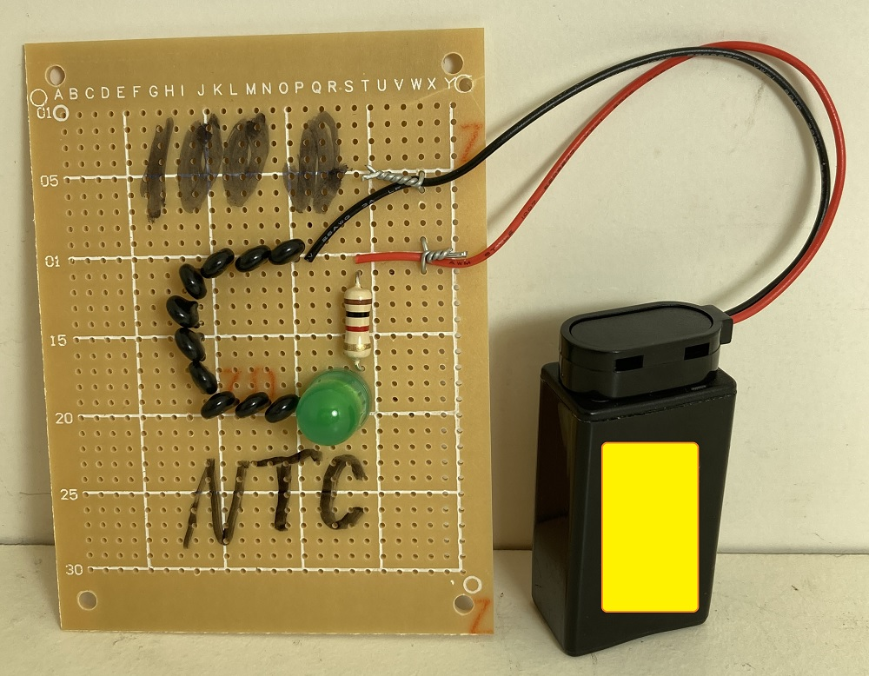
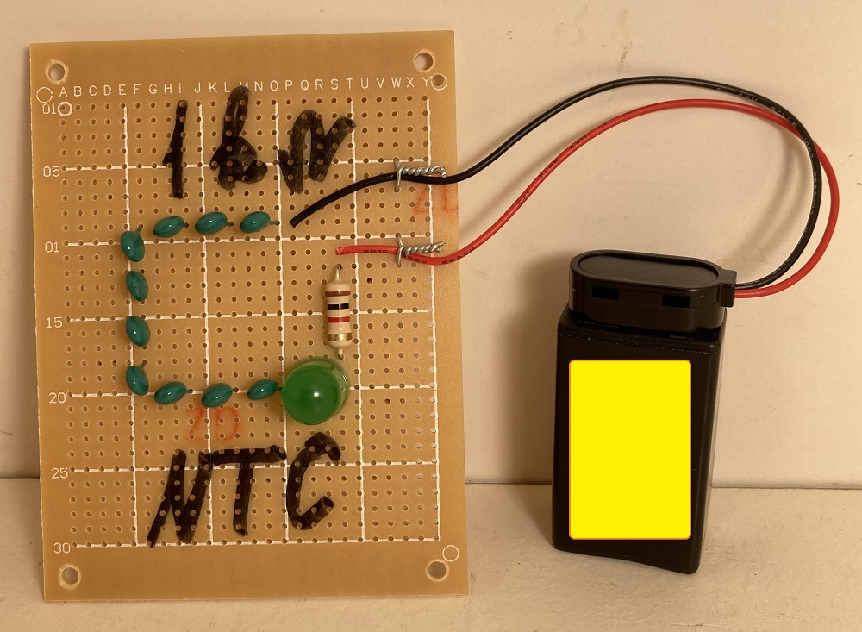
Bad Temperature Indicator Photos

Slide 3
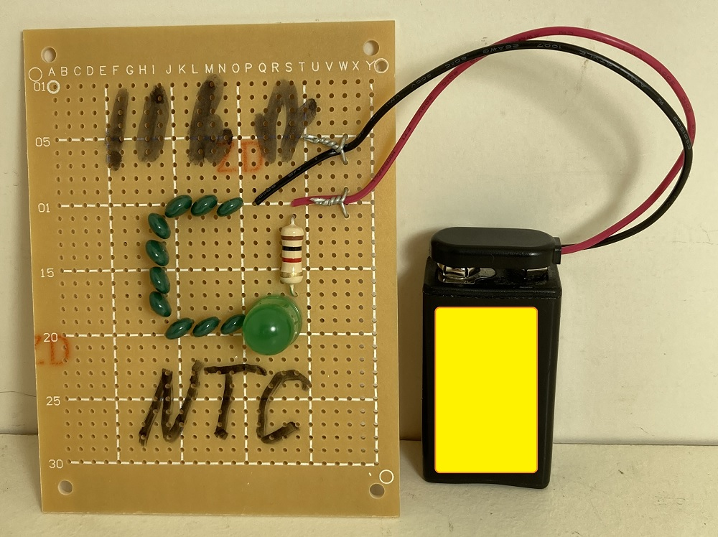
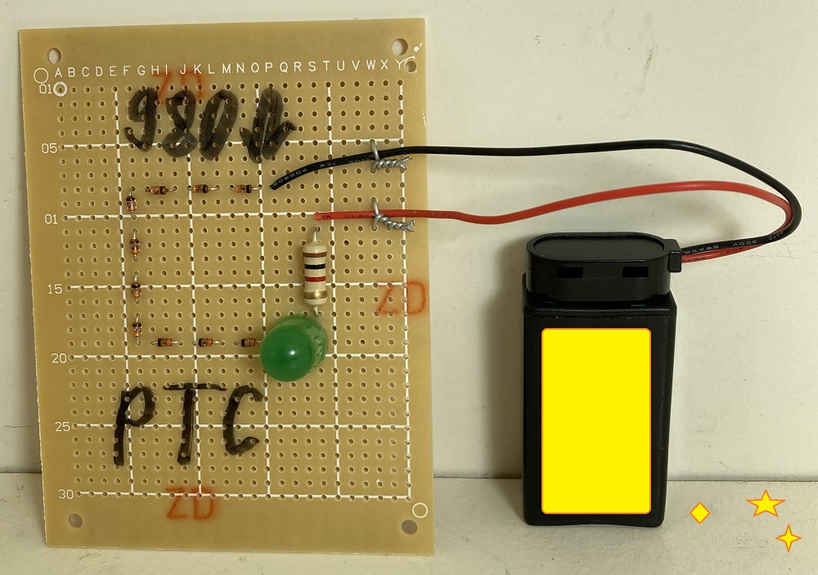
Bad Temperature Indicator Photos

Slide 4
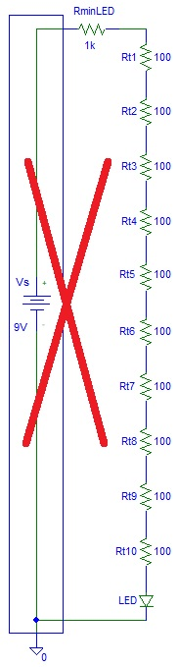
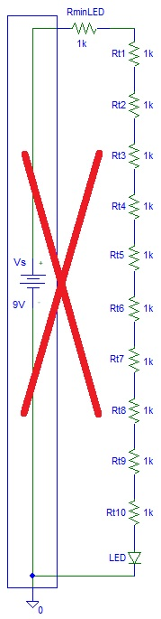
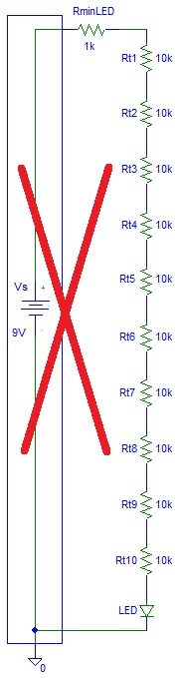
Bad Temperature Indicator Circuits

Slide 5
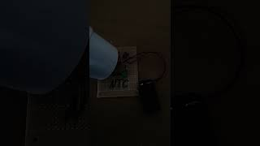
Bad Temperature Indicator Video

Slide 6
References
https://instructables.com/member/diyelectronics
https://hackaday.io/diyelectronics
https://instructables.com/member/simplecircuits
https://hackaday.io/simplecircuits
https://instructables.com/member/simplecomponents
https://hackaday.io/simplecomponents
https://instructables.com/member/cheapcircuits
https://hackaday.io/cheapcircuits
https://instructables.com/member/supercircuits
https://hackaday.io/supercircuits

Slide 7
References
https://instructables.com/member/diycircuits
https://hackaday.io/diycircuits
https://instructables.com/member/usedcomponents
https://hackaday.io/usedcomponents
https://instructables.com/member/recycledcircuits
https://hackaday.io/recycledcircuits
https://instructables.com/member/recycledcomponents
https://hackaday.io/recycledcomponents
https://instructables.com/member/lowcostcircuits
https://hackaday.io/lowcostcircuits

