Slide 1
Primary School Sensors 1
Geraldine Lee
geraldine343@gmail.com
Dr Mark Glickman
drmarkglickman@yahoo.com

Slide 2
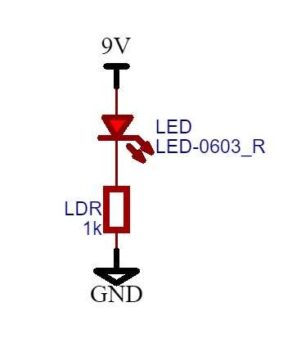
Simple Light Indicator Circuit
Circuit:

Slide 3
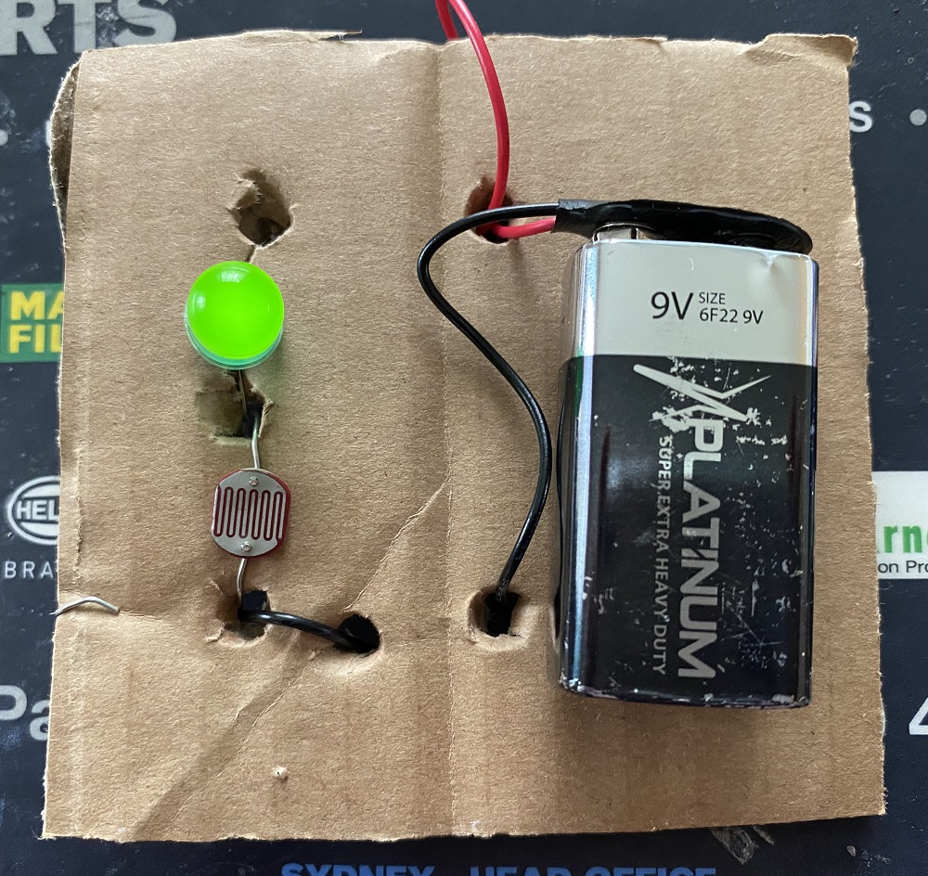
Simple Light Indicator Photo
You can see that the LED is ON in the presence of light.

Slide 4
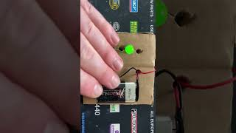
Simple Light Indicator video

Slide 5
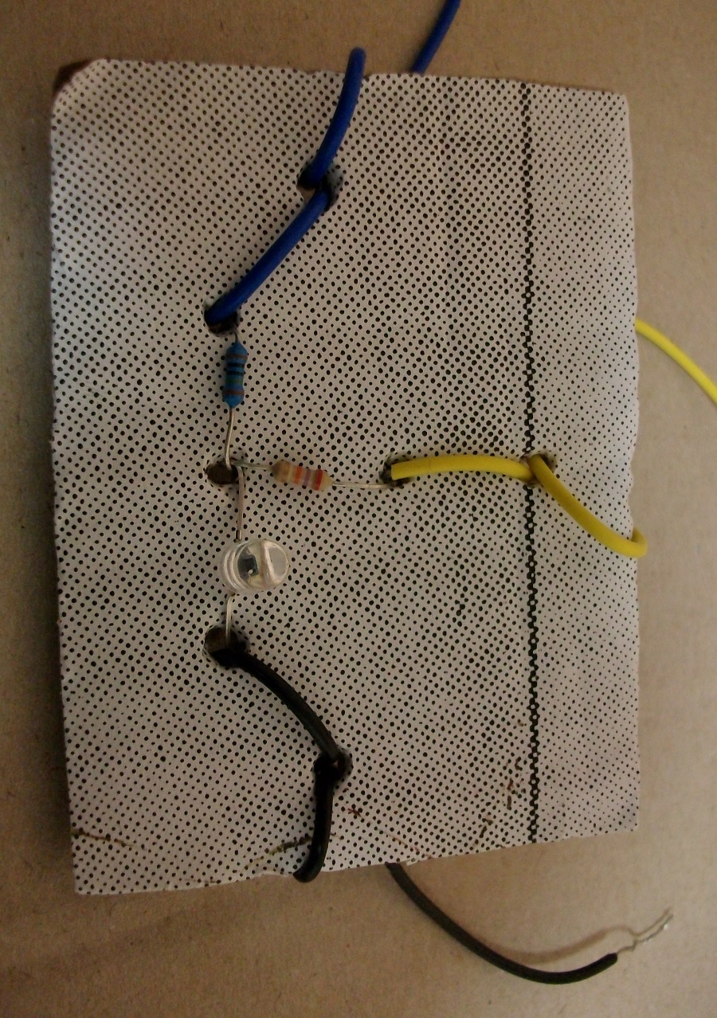
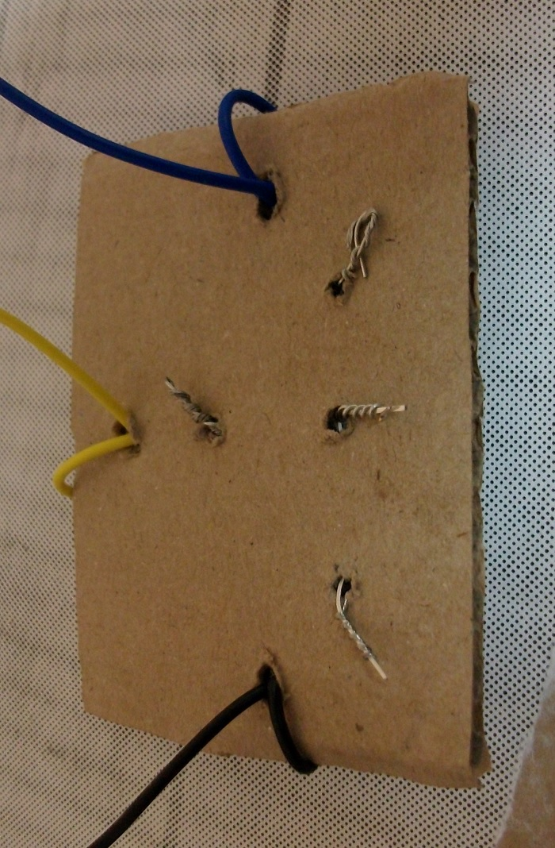
Simple Light and Infrared Sensor
This is how you bias the sensor when making an educational circuit:

Slide 6
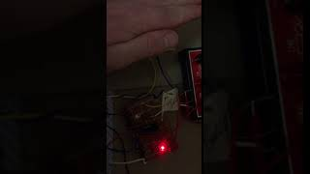
Simple Light and Infrared Sensor

Slide 7
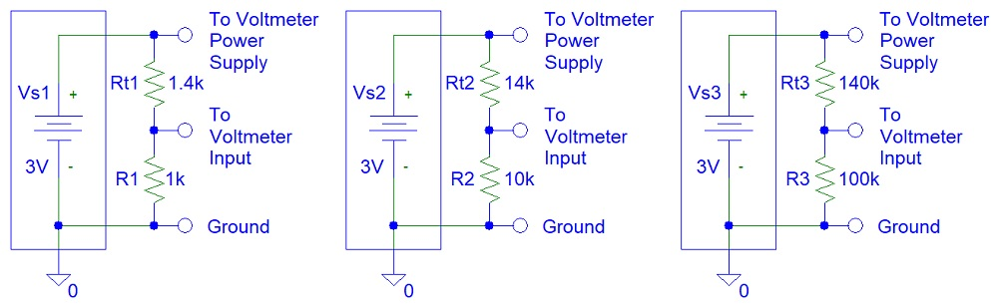
Temperature Meters Circuits

Slide 8
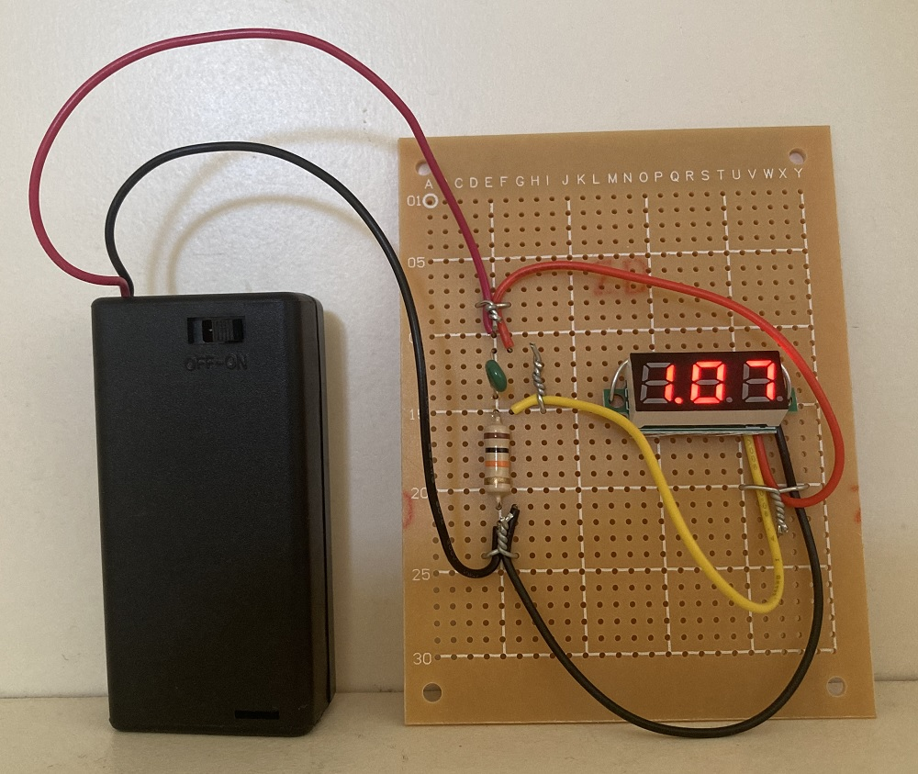
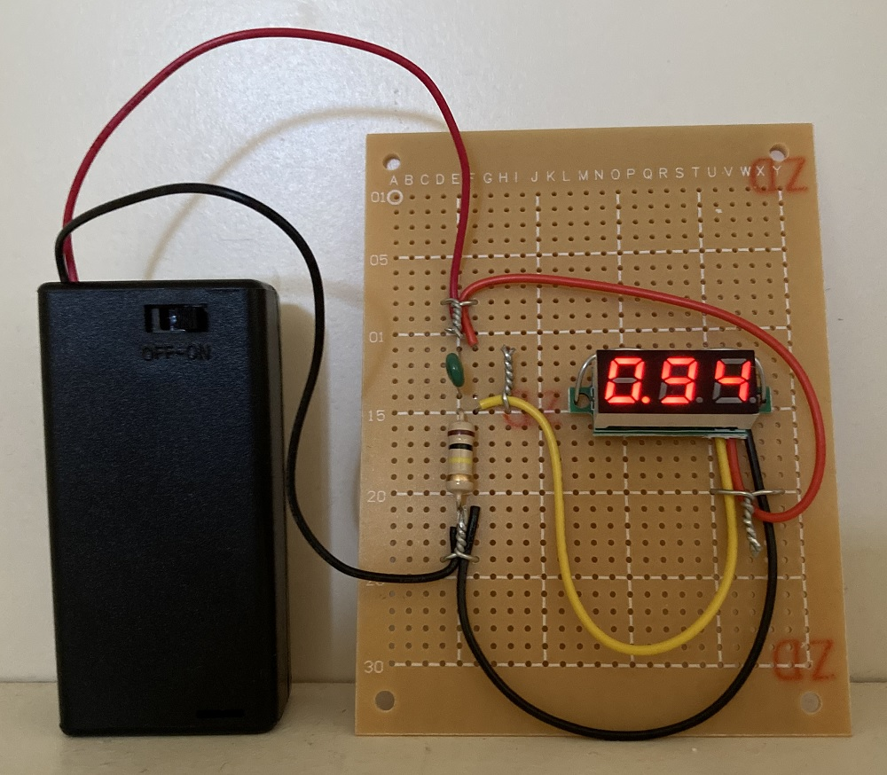
Temperature Meters Photos

Slide 9
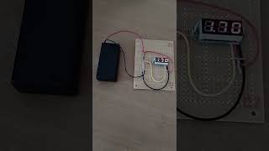
Temperature Meters Video

Slide 10
References
https://instructables.com/member/diyelectronics
https://hackaday.io/diyelectronics
https://instructables.com/member/simplecircuits
https://hackaday.io/simplecircuits
https://instructables.com/member/simplecomponents
https://hackaday.io/simplecomponents
https://instructables.com/member/cheapcircuits
https://hackaday.io/cheapcircuits
https://instructables.com/member/supercircuits
https://hackaday.io/supercircuits

Slide 11
References
https://instructables.com/member/diycircuits
https://hackaday.io/diycircuits
https://instructables.com/member/usedcomponents
https://hackaday.io/usedcomponents
https://instructables.com/member/recycledcircuits
https://hackaday.io/recycledcircuits
https://instructables.com/member/recycledcomponents
https://hackaday.io/recycledcomponents
https://instructables.com/member/lowcostcircuits
https://hackaday.io/lowcostcircuits

